Slide 1
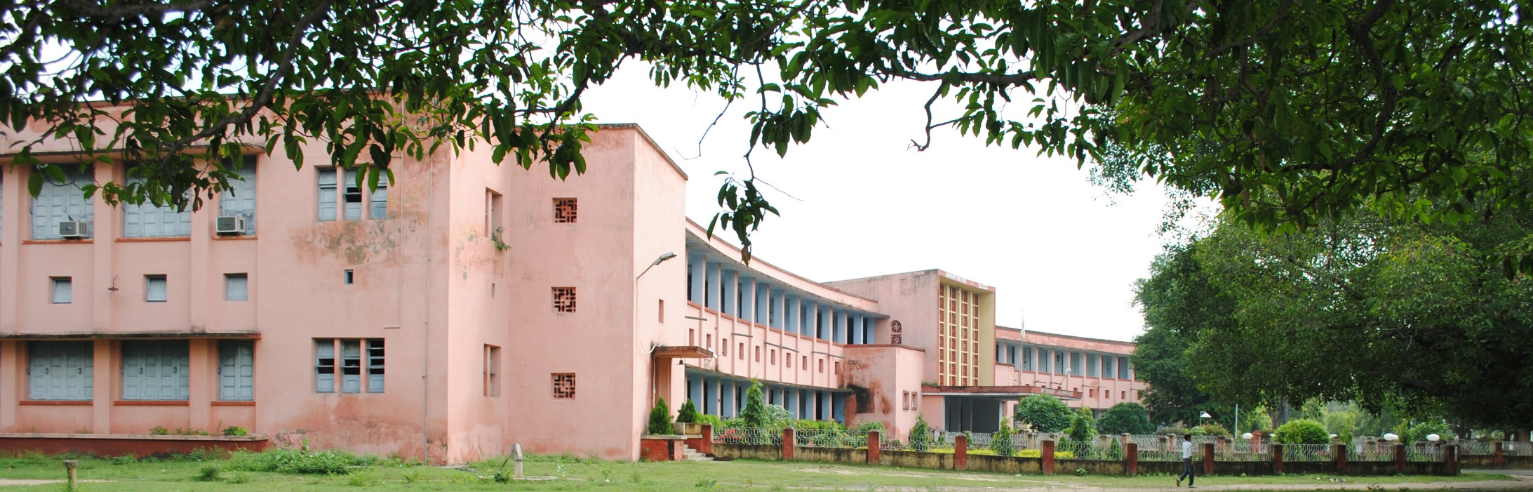
WWW.BITSINDRI.ORG
Vision and Target
-Naresh Sahu

Slide 2
About Me (We called it “introduction”)
Naresh Sahu, Mining 1986-1990.
Joined TISCO as Mining Engineer 1990-1991
Worked as Mining Engineer 1991-2000
Working in IT Industry since 2000 in Washington DC Area

Slide 3
Vision and Target
Revive the old contents
Recollect and validate the Alumni Data – need volunteers – apply online at www.bitsindri.org (High School student volunteers get Community Service Credit Certificates for hours engaged )
Make the Alumni Data Available – on request, by city, by state, by batch - demo
Allow private communication about – job search, matrimony
Open forums for your thought – health improvement, startups
Integrate with facebook, twitter, linkedin

Slide 4
Privacy Concern?
Share your data, your spouse and kids data.
I do have the concern. What to do? I don’t want my data to be published any where.
Try searching yourself in: Google, Anywho.com, Whitepages.com, spokeo.com. There are websites who can tell how many relatives you have in USA and what are there facebook profile

Slide 5
Close Up of that map

Slide 6
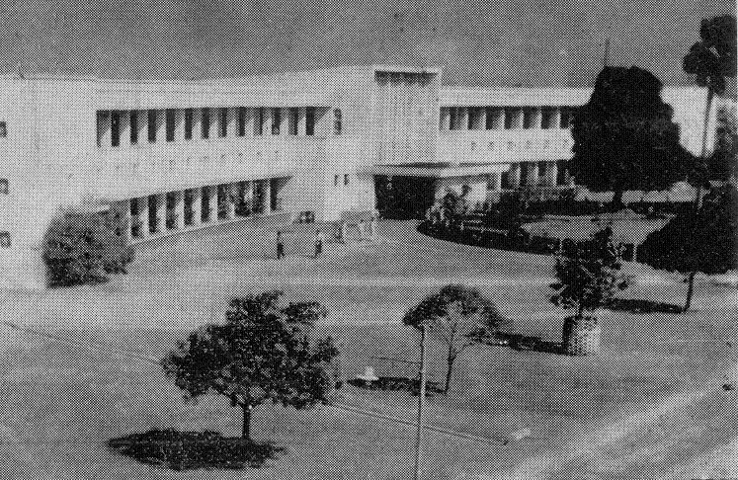
1000 Photos pledge
Yogendra Singh Chadda took this picture with Deshpande Sir's Camera

Slide 7
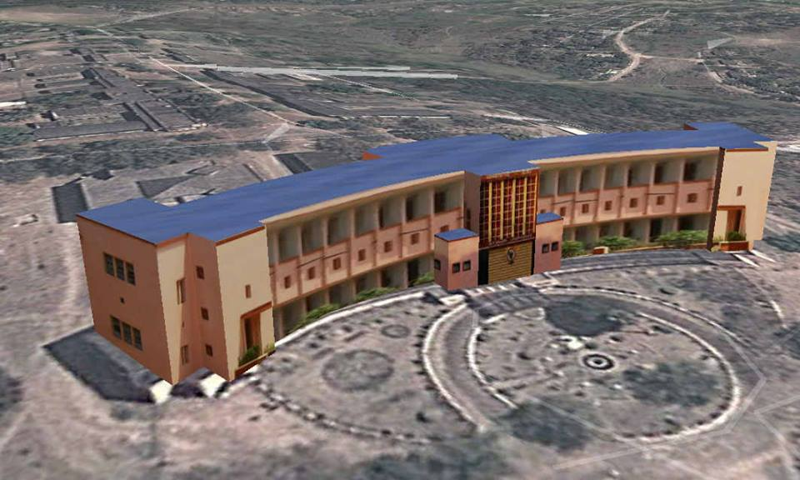
Q&A
Our ADM building- 3D Model- Constructed by Sanjeev Singh 1985 Batch on Google Earth

